Slide 1

Introduction to AI & Big Data Analytics
Artificial Intelligence (AI) is the field of computer science that focuses on creating machines and software that can perform tasks that normally require human intelligence.

Slide 2
These tasks include:
Learning from experience (machine learning)
Understanding language (natural language processing)
Recognizing patterns and objects (computer vision)
Making decisions (planning, reasoning)
Interacting with the environment (robotics)

Slide 3
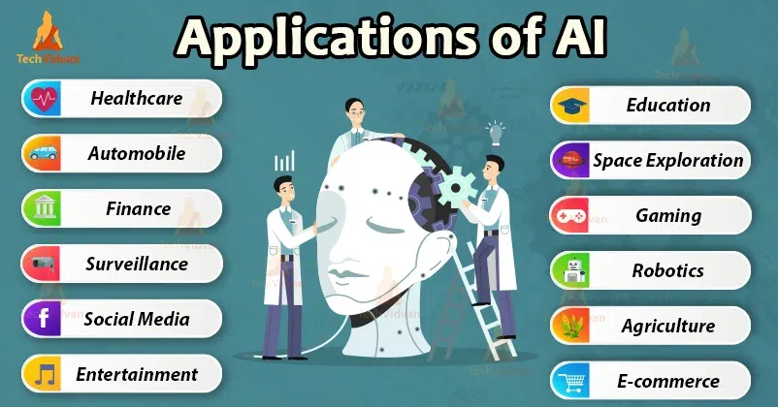
Applications of AI
Natural Language processing(NLP)
Computer Vision
Healthcare
Finance
Robotics
Gaming
Marketing and Advertising
Education

Slide 4
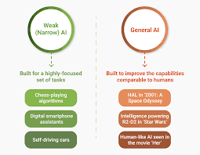
Types of AI
Narrow AI (Weak AI)
Specialized in one task (e.g., Siri, Google Maps, ChatGPT).
2. General AI (Strong AI)
Can perform any intellectual task a human can (still theoretical).

Slide 5

Bigdata
Big Data refers to extremely large and complex datasets that are difficult or impossible to manage, process, or analyze using traditional data processing tools.
Types of Big Data
Structured Data
Unstructured Data
Semi-structured Data

Slide 6
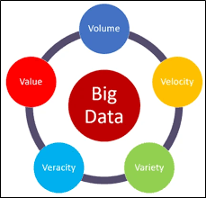
5V’ s of Big Data

Slide 7
Volume – Massive amounts of data (terabytes, petabytes, exabytes).
Velocity – Data is generated and processed at high speed (e.g., real-time data).
Variety – Different types of data: structured (databases), semi-structured (XML, JSON), and unstructured (videos, images, texts).
Veracity – Refers to the quality or reliability of the data.
Variability – To handle the variations in data volume and velocity, systems must be adaptable and expandable.

Slide 8
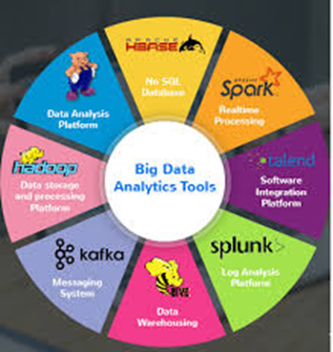
Big Data Analytics
Big Data Analytics is the process of examining large and complex datasets—big data—to uncover patterns, trends, correlations, and insights that can help organizations make better decisions, predict outcomes, and optimize performance.

Slide 9
Big Data Analytics Process
Data Collection – From sources like sensors, logs, social media
Data Storage – Using distributed file systems or cloud storage
Data Cleaning and Preprocessing – Cleaning, transforming, and organizing
Data Analysis – Using algorithms and models to find insights
Data Interpretation and Visualization – Presenting insights in charts, graphs, dashboards
Decision Making and Action – Acting on the insights generated
Predictive Analytics – Looking past data and patterns indicate future trends, behaviors and results.

Slide 10
Relevance of AI and Big Data Analytics
Enhanced Decision Making
Healthcare Advancements
Efficiency and Productivity
Environmental Monitoring
Education And Access
Social Impact

Slide 11
Relevance of Big Data Analytics
Healthcare
Agriculture
Financial Inclusion
Smart Cities
E-commerce and retail
Education
Governance and Public Services
Manufacturing and Logistics
Telecommunications

Slide 12
Understanding AI Concepts
General AI
"General AI" (short for Artificial General Intelligence, or AGI) refers to a type of AI that can perform any intellectual task that a human being can do.
Human-like intelligence: AGI would be able to reason, learn, and adapt across a wide range of domains, just like a human.
e.g Speech Recognition, Image Recognition, Recommendation Systems

Slide 13
Characteristics of General AI
Versatility: Capable of performing variety of intellectual tasks and learning new tasks without additional programming.
Adaptability: Able to transfer learning from one domain (e.g., math) to another (e.g., language or motor skills) without retraining.
Autonomy: Ability to make decisions independently, based on its understanding and reasoning capabilities.
Human-like Cognitive Abilities: Able to transfer learning from one domain (e.g., math) to another (e.g., language or motor skills) without retraining.

Slide 14
Advantages of General AI
Versatility
Efficiency
Innovation
Personalisation
Decision Making
Safety

Slide 15
Disadvantages of General AI
Ethical Concerns
Security Risks
Dependency
Unintended Consequences
Resource Inequality
Existential Risks

Slide 16
Narrow AI
Narrow AI also referred to as weak AI. It trained and developed for a limited set of tasks or a particular task.
Unlike General AI, which aims to replicate human-like intelligence across a broad range of functions, narrow AI focuses on excelling in one domain only.

Slide 17
Characteristics of Narrow AI
Task-Specific:Can perform only the task it was trained for (e.g., image recognition, language translation, playing chess).
Focused expertise: These AI systems excel in a single field but are unable to transfer their knowledge or abilities to other field.
Narrow Scope: They operate within well-defined boundaries and cannot adapt beyond their programmed capabilities. For a speech recognition AI system works on the trained language and will struggle for other language.

Slide 18
Advantages of Narrow AI
Task Efficiency
Cost-Effective
Rapid Deployment
Improved Decision Making
Enhanced User Experience
Safety and Reliability

Slide 19
Disadvantages of Narrow AI
Limited Scope
Dependency on Data
Lack of Flexibility
Ethical Concerns
Integration Challenges
Scalability Issues

